Slide 1




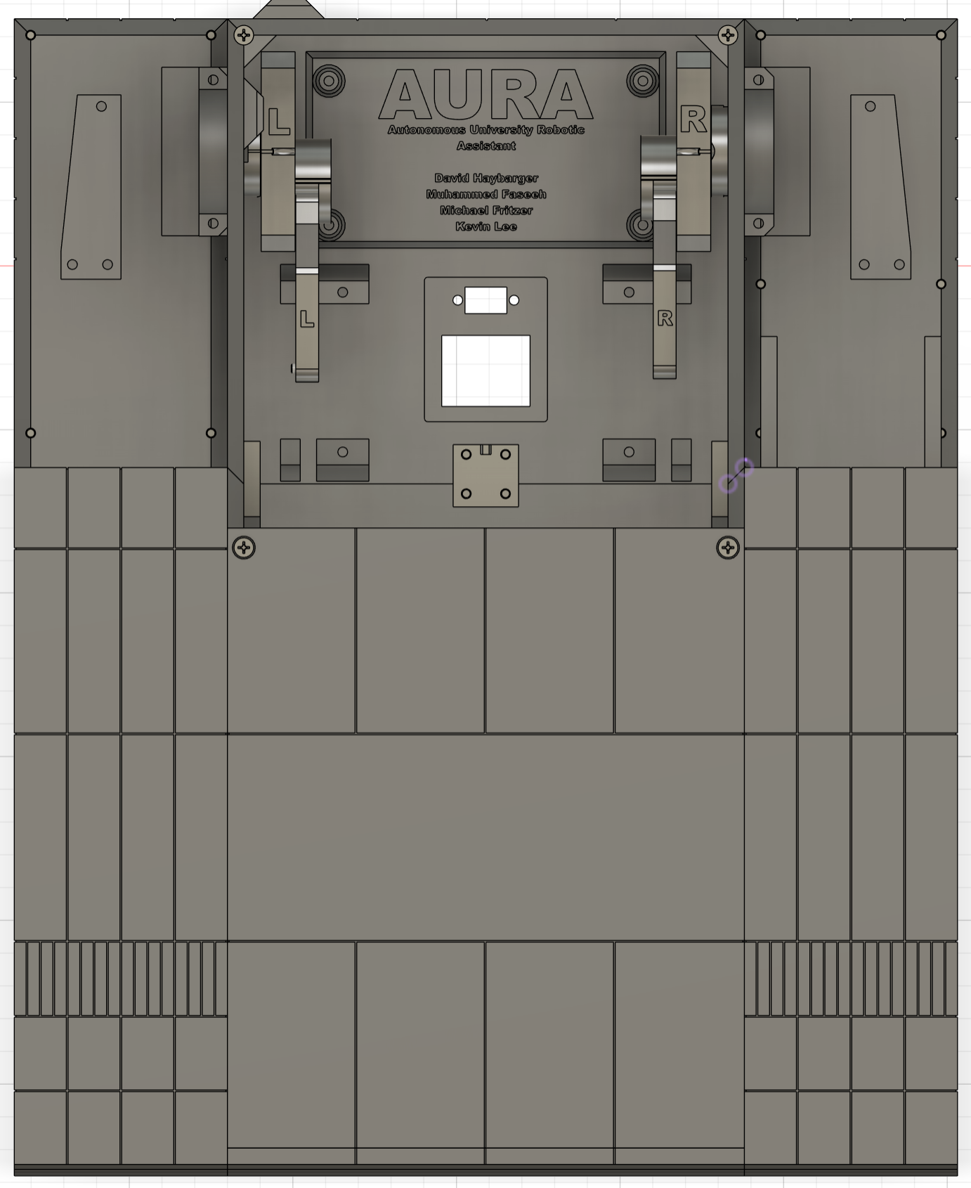
Autonomous University Robotic Assistant
Michael Fritzer, Muhammed Faseeh, David Haybarger, Kevin Lee
Byung-Jun Yoon
Problem Definition
Students and researchers in engineering laboratories often need immediate assistance with lab procedures, troubleshooting, and equipment use. However, teaching assistants and professors are not always available when help is needed. This creates delays, interrupts workflow, and reduces learning efficiency.
Engineering Analysis
Mauris orci mi, varius id diam id, egestas auctor enim. Praesent ut massa nibh. Duis purus neque, facilisis cursus ultrices vel, ullamcorper ac augue [See Figure A]. Done:
Sed in risus nibh. In nisl quam, aliquet sed nibh sitamet, faucibus placerat dui.
Fusce quis augue scelerisque, luctus rum sed, ut dolor. pulvinar urna in eros posuere.
in elementum orci dignissim. Proin semper
Table 1. Caption in, 28 points, italicized.
Chart Title
8.01 | 7.99 | 5.77 | 6.44
4.50 | 3.11 | 9.55 | 1.12
6.15 | 8.00 | 6.18 | 5.65
8.21 | 2.16 | 3.11* | 7.17
3.00 | 9.70 | 10.50 | 4.45
Mauris orci mi, varius id diam id, egestas auctor enim. Praesent ut massa nibh. Duis purus neque, facilisis cursus ultrices vel, ullamcorper ac augue. Donec semper lorem vitae urna pulvinar,.
System Achitecture
Voice & Image Interface
Speech-to-text, text-to-speech, and live object recognition
Artificial Intelligence
Local LLM with Retrieval-Augmented Generation (RAG)
Website / User Interface
Dashboard, camera feed, chatbot, and robot controls
Robotics / Embedded Control
Jetson-to-ESP32 communication for movement and actuation
Power Subsystem
Battery, charging, regulation, and protected power distribution
Outcomes
Mauris orci mi, varius id diam id, egestas auctor enim. Praesent ut massa nibh. Duis purus neque, facilisis cursus ultrices vel, ullamcorper ac augue. Donec semper lorem vitae urna pulvinar,.
Sed in risus nibh. In nisl quam, aliquet sed nibh sit amet, faucibus placerat dui. Fusce quis augue scelerisque, luctus rum sed, porta ut dolor. In
Impact
Mauris orci mi, varius id diam id, egestas auctor enim. Praesent ut massa nibh. Duis purus neque, facilisis cursus ultrices vel, ullamcorper ac augue. Donec semper lorem:
Sed Risus Nibh: CiIn nisl quam, aliquet sed nibh sitamet, faucibus placerat dui augue scelerisque.
Curabitur Accumsan Nulla: Fusce quis augue urna scelerisque, luctus rum sed, ut dolor in pulvinar in eros.
Elementum Orci Dignissim: Proin semper ipsum finibus quam tempor, vitae.
neque dignissim, and in aliquet nisl et umis.
Figure 2. Caption in, 28 points, italicized.
Series 1
Series 2
Series: in et neque dignissim, and in aliquet nisl et umis.
Series 3
Figure 3. Caption in, 28 points, italicized.
Table 1. Caption in, 28 points, italicized.
Figure 4. Caption in, 28 points, italicized.
Chart Title
8.01 | 7.99 | 5.77 | 6.44
4.50 | 3.11 | 9.55 | 1.12
6.15 | 8.00 | 6.18 | 5.65
8.21 | 2.16 | 3.11* | 7.17
3.00 | 9.70 | 10.50 | 4.45
MAURIS ORCI MI VARIUS ID DIAM Egestas auctor enim. Praesent ut massa nibh. Duis purus neque, facilisis cursus ultrices vel, ullamcorper ac augue. Donec semper lorem. Mauris orci mi, varius id diam id, egestas auctor enim. Praesent ut massa nibh. Duis purus neque, facilisis tristique quis augue scelerisque.
References
arXiv:2410.05779 [cs.IR] (LightRAG: Simple and Fast RAG)
Mauris orci mi, varius id diam id, egestas auctor enim
Duis vitae tincidunt tortor, vitae sollicitudin magna
Aenean et est sem. Phasellus nec lectus bibendum
Lacinia magna. Mauris orci mi, varius id diam id, egestas
Mauris orci mi, varius id diam id, egestas auctor enim
Duis vitae tincidunt tortor, vitae sollicitudin magna
*Unamcorper efficitur sed in nulla.

